Slide 1

Microservices and FaaS for Offensive Security
Ryan Baxendale
BSides Las Vegas (2017)

Slide 2
$ whoami
Ryan Baxendale
Penetration Tester
Centurion Information Security Pte Ltd - www.centurioninfosec.sg
Singapore
twitter.com/ryancancomputer
github.com/ryanbaxendale
linkedin.com/in/ryanbaxendale

Slide 3

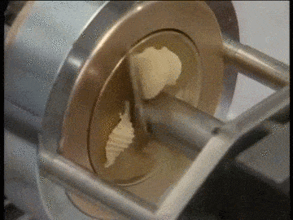
AWS Lambda
Jan 2015 - AWS Lambda Preview
Open to all AWS Customers
Upload your code and trigger it to run
Scales quickly
1,000,000 code runs for free every month
Only supported node.js
lambdash: AWS Lambda Shell Hack
By Eric Hammond
https://github.com/alestic/lambdash
Run shell commands using node.js

Slide 4
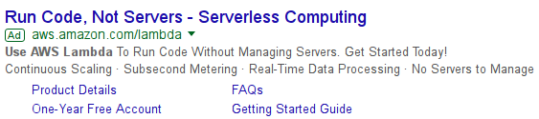
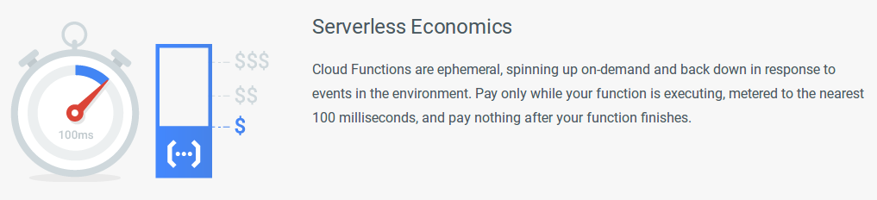
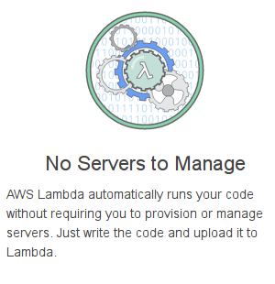
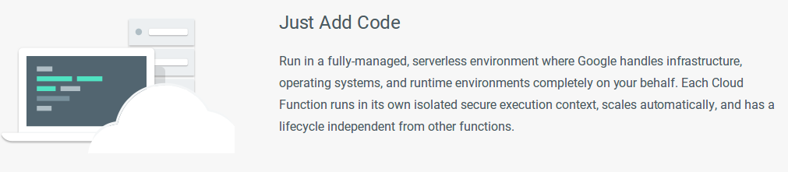
Servers are dead...
“Serverless”

Slide 5
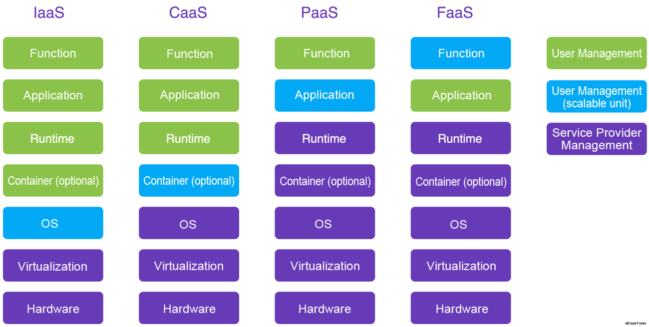
The stack
Microservices
Code
Source: https://intl.aliyun.com/forum/read-499
Notes:
Image sources:
https://intl.aliyun.com/forum/read-499

Slide 6
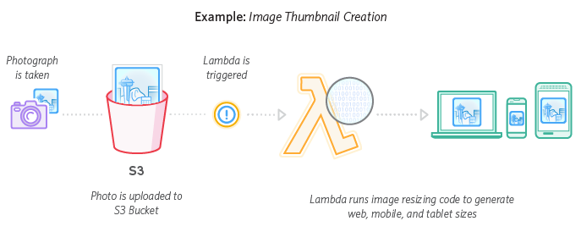
Real-time File Processing
https://aws.amazon.com/lambda/
Notes:
Image sources:
https://aws.amazon.com/lambda/

Slide 7



Scale
https://github.com/airbnb/streamalert
StreamAlert is a serverless, realtime data analysis framework which empowers you to ingest, analyze, and alert on data from any environment, using datasources and alerting logic you define.
https://github.com/0x4D31/honeyLambda
honeyλ - a simple serverless application designed to create and monitor URL {honey}tokens, on top of AWS Lambda and Amazon API Gateway
https://github.com/goadapp/goad
Goad is an AWS Lambda powered, highly distributed, load testing tool built in Go
https://github.com/davbo/lambda-csp-report-uri
Simple python application which runs on AWS Lambda and writes CSP reports into S3 for later processing
https://github.com/therefromhere/csp_lambda
AWS Lambda function to store Content Security Policy reports in ElasticSearch

Slide 8
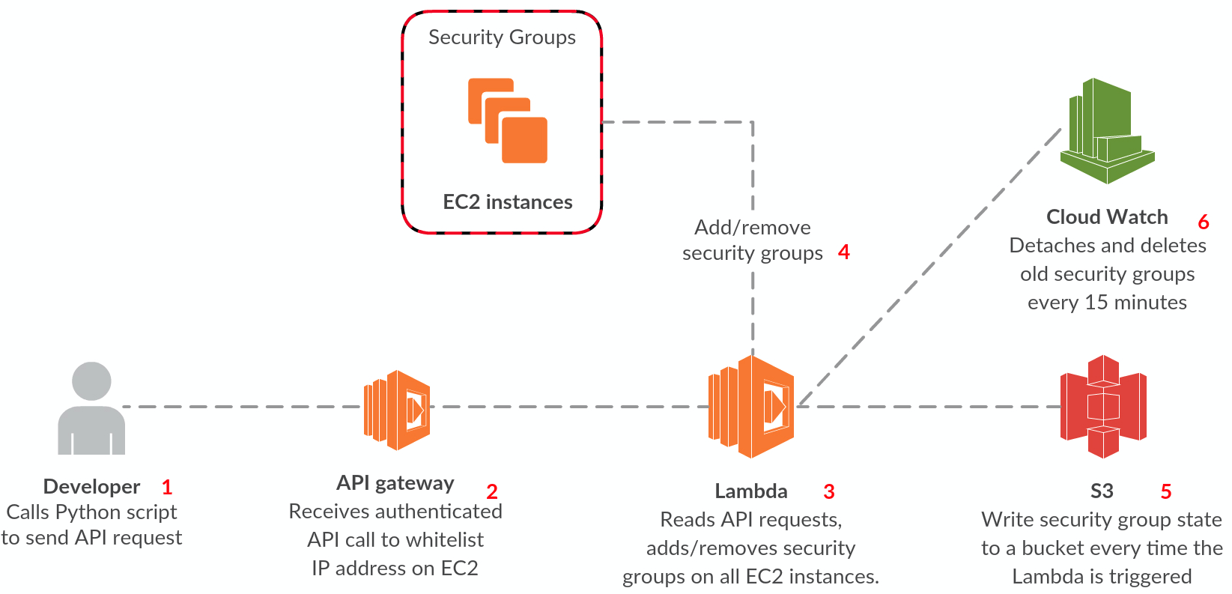
Automate
https://github.com/marekq/aws-lambda-firewall
Create temporary security groups on your EC2 instances through a simple API call. In addition, audit your security groups easily by the use of automated reports written to S3.
https://github.com/ilijamt/lambda_security_group_manager
Auto managing your AWS security groups with Lambda
https://github.com/johnmccuk/cloudflare-ip-security-group-update
Lambda function to retrieve Cloudflare's IP address list and update the specified security group

Slide 9
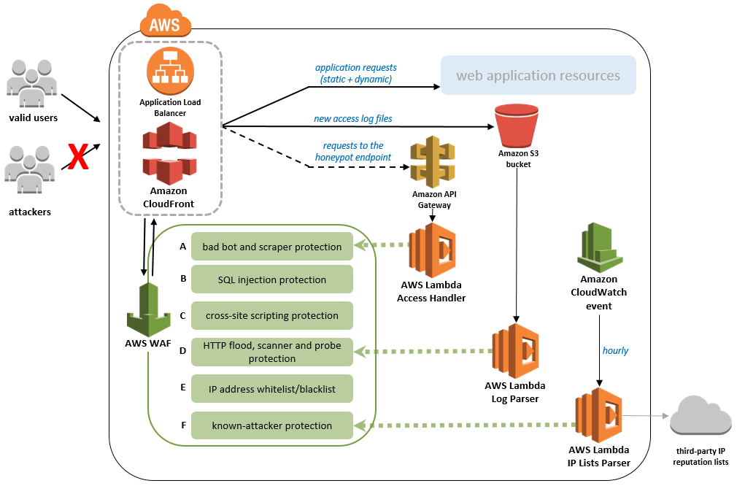
AWS WAF Automation
https://aws.amazon.com/answers/security/aws-waf-security-automations/
Parse application logs and trigger WAF rules
Honeypot
Log parsing (db scraping)
Use third party IP reputation lists

Slide 10
Hello World from the Serverless cloud

Slide 11

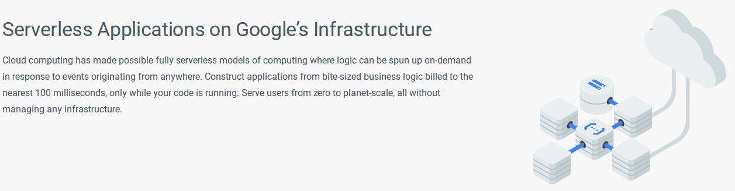
Hello Serverless World

Slide 12
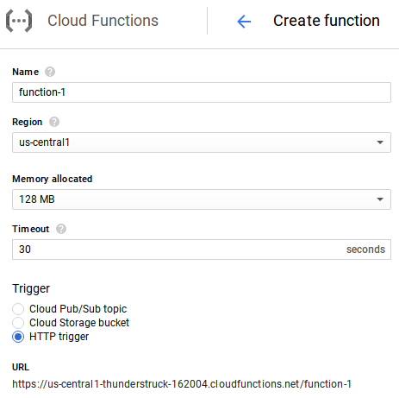
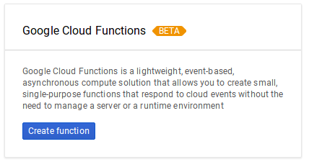
Hello World on Google Cloud Functions (1/4)
Support for Node.js
Run Python scripts from Node.js with simple (but efficient) inter-process communication through stdio
https://github.com/extrabacon/python-shell

Slide 13
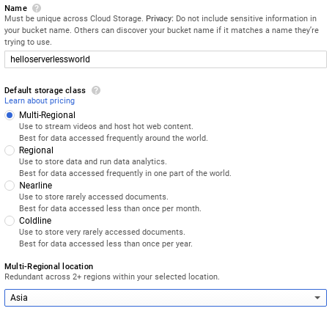
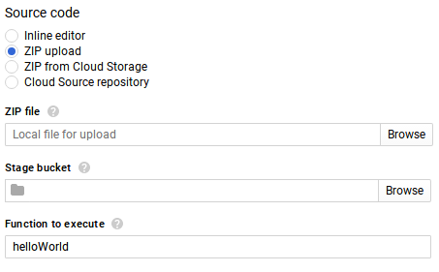


Hello World on Google Cloud Functions (2/4)

Slide 14
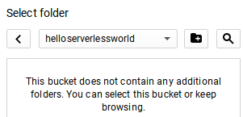
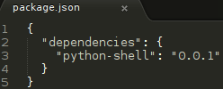

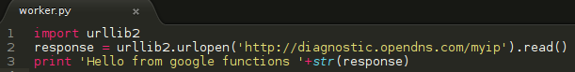

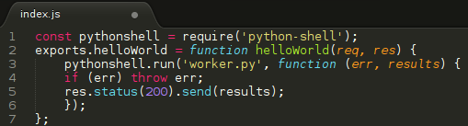
Hello World on Google Cloud Functions (3/4)
$ npm install --save python-shell
$ mkdir python
$ touch python/worker.py
$ zip helloworld.zip -r python/ index.js package.json node_modules/

Slide 15
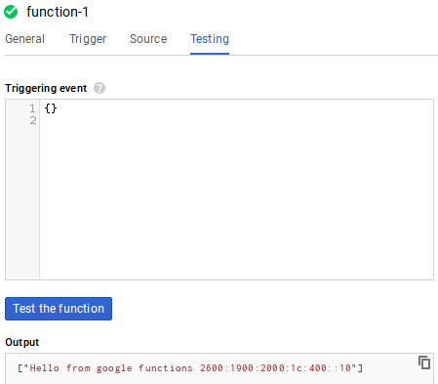
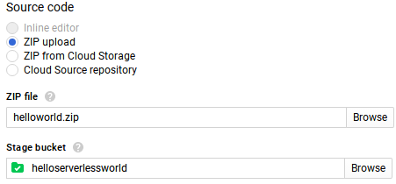

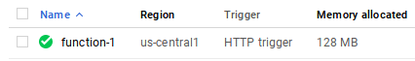
Hello World on Google Cloud Functions (4/4)
IP address is
2600:1900:2000:1c:400::10

Slide 16
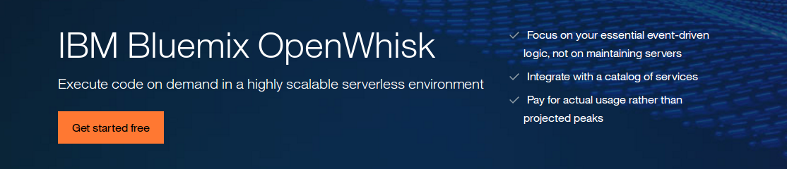
Hello Serverless World

Slide 17

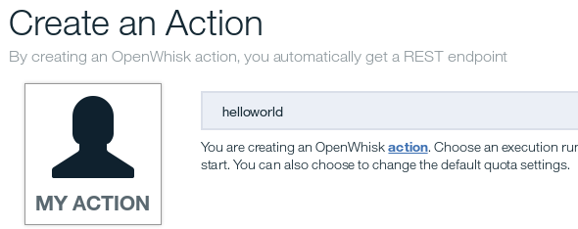
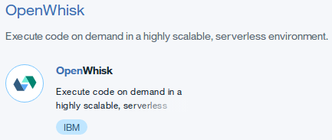
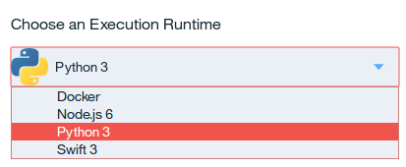
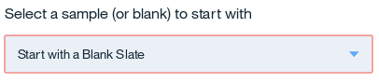
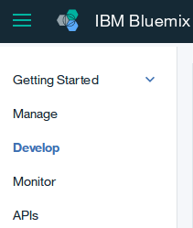




Hello World on IBM OpenWhisk (1/2)

Slide 18
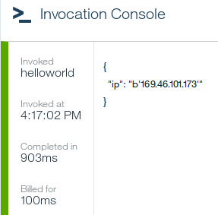
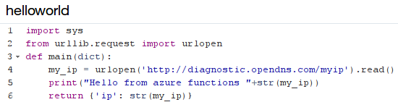


Hello World on IBM OpenWhisk (2/2)
Python3
IP address is 169.46.101.173

Slide 19
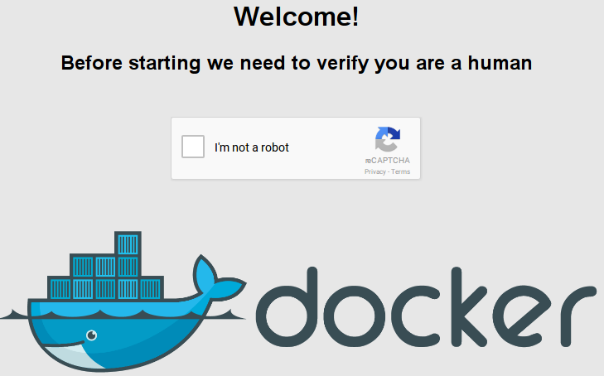
Hello Serverless World

Slide 20
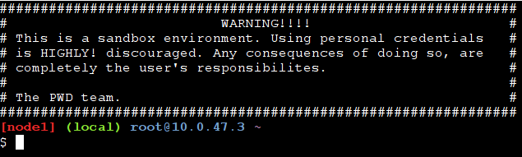
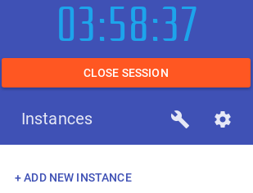
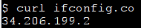
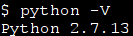
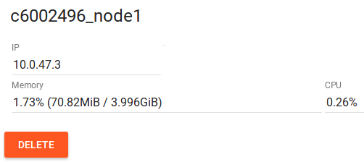
Hello World on Play with Docker
Hosted: http://www.play-with-docker.com/
Build your own: https://github.com/alexellis/faas
A serverless framework for Docker
$ dig +short -x 34.206.199.2
ec2-34-206-199-2.compute-1.amazonaws.com.
+Anonymous (no account)
-time limited
-captcha

Slide 21


Slide 22
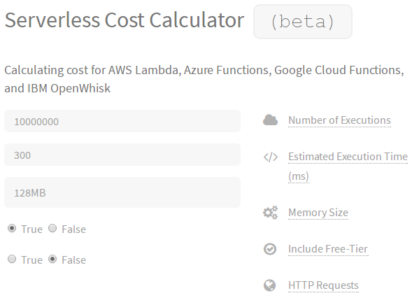
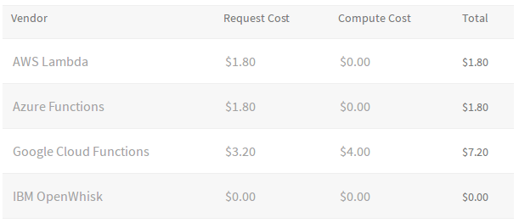
Cost
AWS: “1M free requests per month and 400,000 GB-seconds of compute time per month”
128 MB = 3,200,000 free seconds per month
Then $0.000000208 per 100ms
300ms - 10 million executions for $1.80
Simple Hello World function to get current IP
http://serverlesscalc.com/

Slide 23
FaaS support by region
AWS
US East (N. Virginia)
US East (Ohio)
US West (N. California)
US West (Oregon)
Canada (Central)
EU (Ireland)
EU (Frankfurt)
EU (London)
Asia Pacific (Singapore)
Asia Pacific (Sydney)
Asia Pacific (Seoul)
Asia Pacific (Tokyo)
Asia Pacific (Mumbai)
South America (São Paulo)
Azure
East US
East US 2
West US
West US 2
South Central US
North Central US
Central US
Canada Central
Canada East
North Europe
West Europe
UK West
UK South
Southeast Asia
East Asia
Japan West
Azure
17. Japan East
18. Brazil South
19. Australia East
20. Australia Southeast
22. Central India
23. South India
IBM
US South
Google
IOWA (us-central1)
Play with Docker
(AWS)

Slide 24
Overview
 | Google | IBM | AWS | Azure
Regions | 1 | 1 | 14 | 23
Language | Node.js (Python) | Docker Node.js 6 Python 3 Swift 3 | Edge Node.js 4.3 Node.js 4.3 Node.js 6.10 Python 2.7 Python 3.6 | Bash, Batch C#, F# JavaScript Php, PowerShell Python, TypeScript
OS (Python) | Linux Debian 8.8 | Linux Ubuntu 14.04.1 | Linux 4.4.51-40.60.amzn1.x86_64 | Windows Server 2012
Network | IPv6 | IPv4 | IPv4 | IPv4

Slide 25
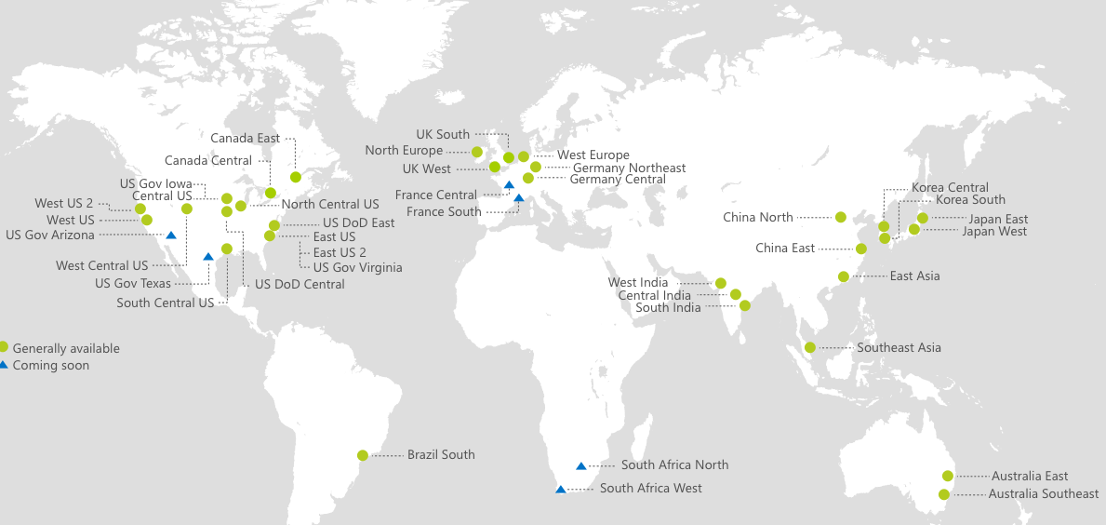
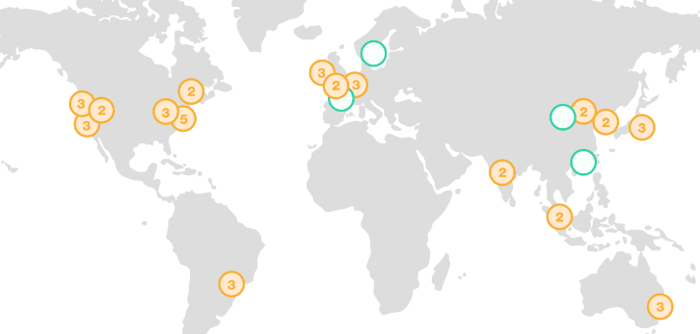
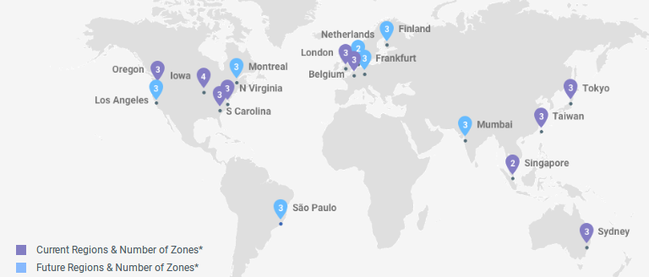
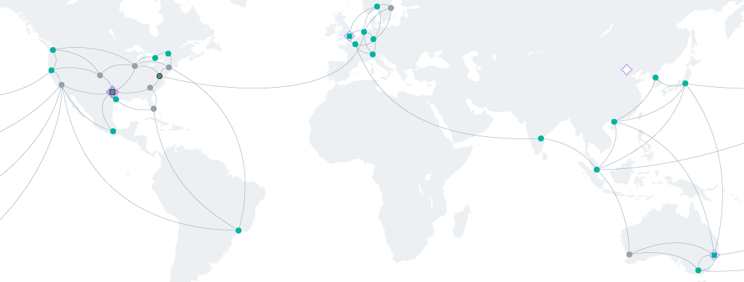
Advantages
Azure
Low cost (“free”)
Sign up credit
Unspecified source IP addresses
Possibly low attribution
Global data centers
China
AWS
Google
IBM Bluemix

Slide 26


Project Thunderstruck
Finding use cases for FaaS in offensive security
Notes:
http://www.ddoughty.com/uploads/1/4/0/9/14095491/7242725_orig.jpg
https://giphy.com/gifs/lightning-WrmDZ1I5kn5ao

Slide 27
Project Thunderstruck
Finding use cases for FaaS in offensive security
Explore different cloud service providers
Try to get supercomputer resources without paying supercomputer prices
BSidesLV 2017
Searching in IPv6

Slide 28
Searching in IPv6
NOERROR but keep looking

Slide 29
Past work
You can -j REJECT but you can not hide: Global scanning of the IPv6 Internet
- Tobias Fiebig
December 2016
33C3: 33rd Chaos Communication Congress, Hamburg, Presenting first steps towards scanning IPv6 globally.
https://media.ccc.de/v/33c3-8061-you_can_-j_reject_but_you_can_not_hide_global_scanning_of_the_ipv6_internet
https://www.cs.ucsb.edu/~vigna/publications/2017_PAM_CollectingIPv6.pdf
https://gitlab.inet.tu-berlin.de/ptr6scan/toolchain
Finding v6 hosts by efficiently mapping ip6.arpa
- Peter van Dijk
March 2012
http://7bits.nl/blog/posts/finding-v6-hosts-by-efficiently-mapping-ip6-arpa
https://tools.ietf.org/html/rfc7707

Slide 30
Standard-Compliant Nameservers (DNS)
Something From Nothing (There): Collecting Global IPv6 Datasets From DNS
Tobias Fiebig, Kevin Borgolte, Shuang Hao, Christopher Kruegel, Giovanni Vigna
PAM (Passiv and Active Measurement) Conference 2017, Sydney
NOERROR
Keep looking
NXDOMAIN
Give up there's nothing here
“Complementary to prior approaches, van Dijk enumerates IPv6 reverse records… When correctly implementing RFC1034, as clarified in RFC8020, the Name Error response code (NXDOMAIN in practice) has the semantic of there is nothing here or anywhere thereunder in the name tree.”
“Combined with the IPv6 PTR DNS tree, where each subzone has 16 (0-f, one for each IPv6 nibble) children up to a depth of 32 levels, provides the possibility to exploit standard-compliant nameservers to enumerate the zone”
Notes:
https://www.cs.ucsb.edu/~vigna/publications/2017_PAM_CollectingIPv6.pdf

Slide 31
Let’s dig over here
$ dig 1.0.0.0.0.0.0.0.0.0.2.0.1.0.0.2.ip6.arpa.
;; Got answer:
;; ->>HEADER<<- opcode: QUERY, status: NOERROR, id: 18347
;; flags: qr rd ra; QUERY: 1, ANSWER: 0, AUTHORITY: 0, ADDITIONAL: 1
There are records to be found within:
1.0.0.0.0.0.0.0.0.0.2.0.1.0.0.2.ip6.arpa.
2001:0200:0000:0001:...
$ dig 5.0.0.0.0.0.0.0.0.0.2.0.1.0.0.2.ip6.arpa.
;; Got answer:
;; ->>HEADER<<- opcode: QUERY, status: NXDOMAIN, id: 58924
;; flags: qr rd ra; QUERY: 1, ANSWER: 0, AUTHORITY: 0, ADDITIONAL: 1
Nothing to be found within:
5.0.0.0.0.0.0.0.0.0.2.0.1.0.0.2.ip6.arpa.
2001:0200:0000:0005:...

Slide 32
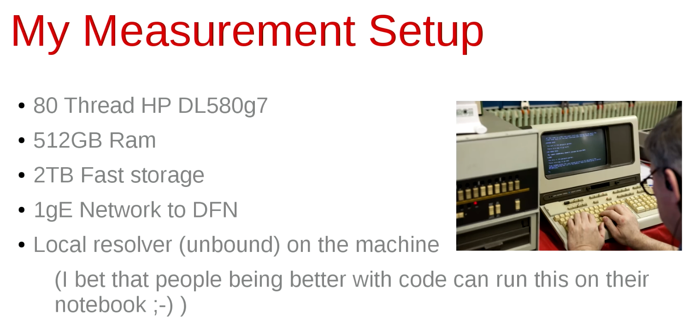
Super Computer
Tobias Fiebig, University computer used for Machine Learning

Slide 33
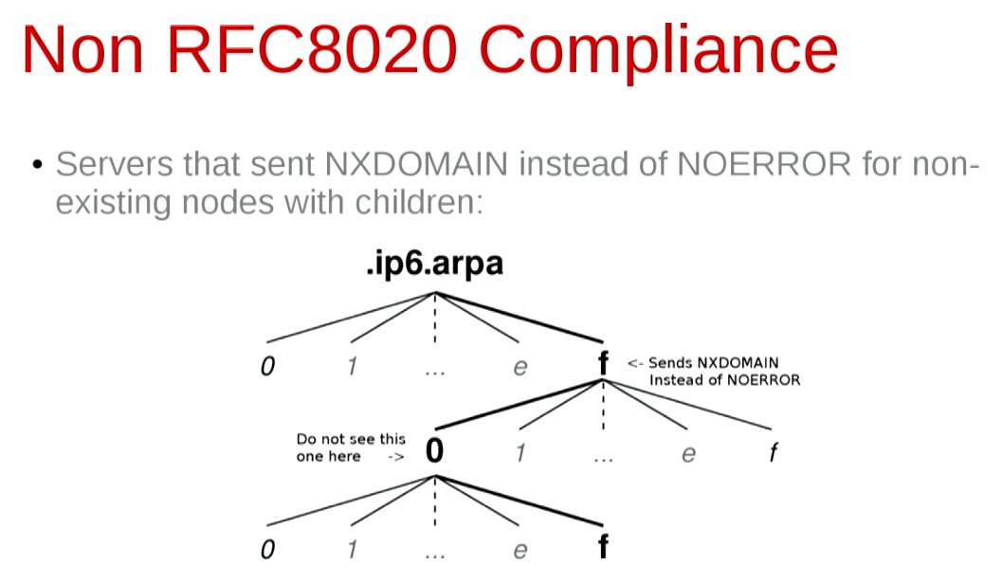
Results and Limitations
1st Attempt
Breadth first search
1 week
70M+ records
Received complaint email from large ISP
Dynamic reverse zones
2nd Attempt
Detect and ignore auto-gen zones
3 days (65.53 hours)
1.6M records
Not all DNS servers reply with NOERROR

Slide 34
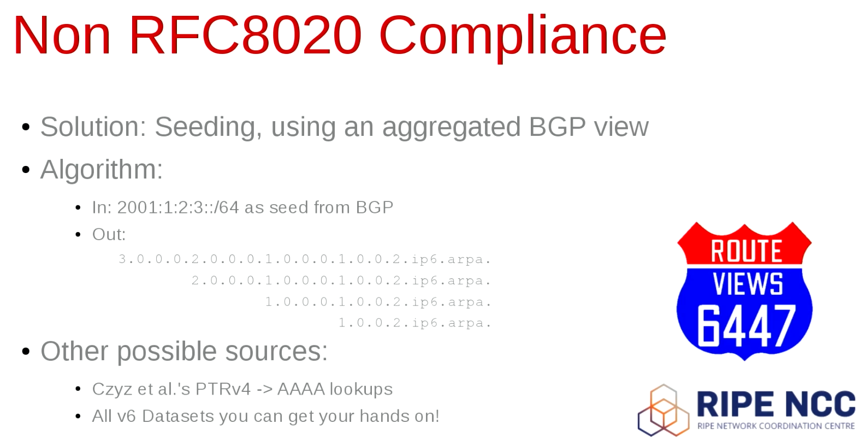
Seeding

Slide 35

Scale to Fail
3rd Attempt
70.5 hours
80 threads
5.3M records
4th Attempt
22.2 hours
400 threads
2.2M records <--- :’(
“Lesson: use more than one IP address”
“Server ran out of sockets”
Good use case for FaaS?
Bash script
curl/wget routing data
BGPdump
sort --parallel | uniq
parallel cook_down.py
parallel extract_terminals.py

Slide 36




The Plan
Question to Tobias Fiebig during 33c3:
Q: “Where is the dataset?”
A: “It’s actually stored in a distributed manner on a lot of DNS servers”
Download public routing information (BGP) for advertised IPv6 networks
Parse and create a list of starting IPv6 addresses
Run worker to enumerate each starting address
Write any discovered PTR records to DynamoDB
Look for interesting stuff in DynamoDB web interface
DynamoDB
AWS Lambda

Slide 37
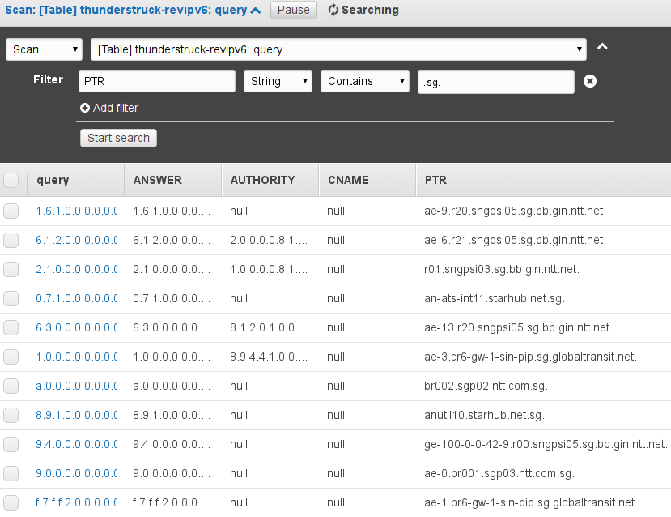

Architecture
NOERROR
6) Spawn new worker
PTR record
5) Store PTR record
1) Get RIS Raw data
2) Get Route Views data
3) Parse and store IPv6 prefixes
4) Start worker IPv6
getdata.py
start_workers.py

Slide 38

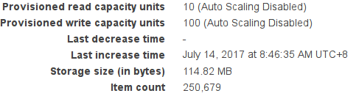
Start the workers!
$ ./getdata.py
$ ./start_workers.py
Need to spawn 55548.0 workers to lookup 55548 with 1 ipv6 address per worker
02:59:47.796904 - starting revipv6
02:59:47.865480 - starting workers
03:05:36.023268 - done starting workers
finished starting workers in 0:05:48.157793
250k+ records found
That was fast, but where are all the records?
Notes:
https://media.giphy.com/media/3o7btPCcdNniyf0ArS/source.gif

Slide 39
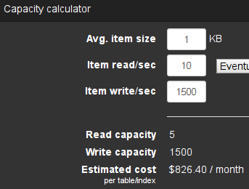
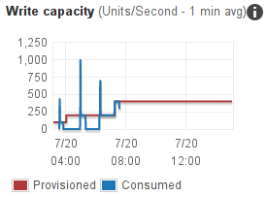
Learning to scale
CloudWatch logs:
An error occurred (ProvisionedThroughputExceededException) when calling the PutItem operation (reached max retries: 9): The level of configured provisioned throughput for the table was exceeded.
Too many concurrent attempts to write to DynamoDB
Need to scale the DynamoDB storage backend
USD$ 826/month!

Slide 40

Improvements
Remove the recursive function call
Scales too quickly for too little work
Create depth search limit
Only look 4, 8, 16, 24, 32 addresses deep from each starting point
Start workers slowly
Don’t try to look up all possible reverse DNS entries for every IPv6 address in under 5 minutes
Scale up DynamoDB when needed
Scale down when idle
DynamoDB web interface is slow and clunky at search (“scan”)
Let’s look at some results
Notes:
https://media.giphy.com/media/yUrUb9fYz6x7a/giphy.gif

Slide 42
KVM
Intelligent Platform Management Interface (IPMI)
ipmi.k7-a14-lt1.kvm.serveriai.lt
ash-ipmi.bootc.eu
esx3-ipmi.sgef.hu
ipmi.origo.nmugroup.se
meter5-test-ipmi.meter.cesnet.cz
dfw1-ipmi.psg.com
vm0-ipmi.iad.rg.net
hippo-ipmi.nist.gov
monitoring-ipmi.dataix.ru
Integrated Lights-Out (iLO)
ilo.app9.mia2.afilias-nst.info
vrrp.ilo.cpr1.lax1.afilias-nst.info
vm11-ilo-gs1-gcn.tgsa.co.uk
tur-esxfw1-ilo.massey.ac.nz
OOB
gate-2-oob.belval.restena.lu
oob.core.nrc.ca
interface-3--hoc1-m15-01-hnd.oob.sfdc.net
oob-dc2.ksrv.fr
xrc1-oob.1d12.xs4.mendix.net
internal-240.fw-oob.workbone.pironet-ndh.com
eth0.oob-pix.egh.uk.mdnx.com
Integrated Dell Remote Access Controller (iDRAC)
insphl-idrac.spawar.navy.mil
djs-sandiego-proto-idrac.mgmt.dren.mil
idrac-vmhost6.copernica.nl
perez-drac.lusem.edu
drac1.softlab.ece.ntua.gr
pc19-drac.otemachi.wide.ad.jp

Slide 43
Gov
.mil
djs-sandiego-proto-idrac.mgmt.dren.mil
fw.sd.spawar.navy.mil
sentinel.tni-au.mil.id
blackbox.tni-au.mil.id
incognito.tni-au.mil.id
www-largedata-proj.cmf.nrl.navy.mil
remote.mda.mil
stafflan.svcs.dren.mil
.gov
sec1sgw1.internet.gov.sa
gcca-new-transit-core-gcc.fnal.gov
VRRPv6.s3.bnl.gov
ir2-n1--vlan501.hsrp.lbl.gov
bluecoat-sg-cadev-3.ca.sandia.gov

Slide 44
Infrastructure
EQIX-EMA-SV-IPV6.softbanktelecom.com
EQIX-EMA-NY-IPV6.bankofnymellon.com
EQIX-EMA-NY-IPV6.centrilogic.com
EQIX-EMA-LA-IPV6.cloudflare.com
EQIX-EMA-DA-IPV6.oraclecorporation.com
EQIX-EMA-SV-IPV6.evernote.com
EQIX-EMA-NY-IPV6-HSRP-gateway.ny.equinix.com
EQIX-V6-MA-dc.box.com
EQIX-MA-CH-IPV6.twitter.com
EQIX-MA-SV-IPV6.vmware.com
EQIX-MA-DA2-IPV6.NETFLIX.com
lo0.gw102.me1.ap.equinix.com
xe-0-0-0.gw603.hk3.ap.equinix.com
xe-0-0-0.gw101.ty4.ap.equinix.com
xe-0-1-0.gw401.sg1.ap.equinix.com
loop0.gw01.stjh.nf.aliant.net
loop0.cmts01-cres.mql.ncable.net.au
loop0.ubr10k.omnitel.biz
loop0.core1.camphill.dcsi.net.au
loop0.pling.v6.ngdc.net
loop0.23w.ba07.sydn.ns.bellaliant.net
loop0.hkg-mgi-mgmt-1.megaport.com
loop0.sin-sg2-mgmt-1.megaport.com
backbone-v6-r23.ictvalleumbra.it

Slide 45
Quantum Computing
NASA
dwave-fw.nas.nasa.gov
dwave-pp2.nas.nasa.gov
dwave-qubist.nas.nasa.gov
dwave-monitor.nas.nasa.gov
dwave-qc.nas.nasa.gov
heliophysicsdata.sci.gsfc.nasa.gov
rtr-s28-40g-v6.sci.gsfc.nasa.gov
oceanpost.sci.gsfc.nasa.gov
voyager.sci.gsfc.nasa.gov

Slide 46
Summary
Received zero abuse emails
Lessons learned:
Recursive functions that call themself quickly multiple beyond control
Limit recursive calls
Always make sure your backend data storage will scale
Elasticsearch is expensive to scale and likely can’t handle the workload
Going further
More data sources for seeding
https://github.com/trustedsec/hardcidr
Public datasets, Certificate transparency, Forward DNS dataset, DNS, scans.io
https://github.com/appsecco/bugcrowd-levelup-subdomain-enumeration
Create workflow with DynamoDB Triggers to run another Lambda function (portscan, find matching ipv4, etc)
AWS Lambda free tier is per region
Reduce cost even further by allocating workload to regions with free compute

Slide 47

Further work

Slide 48
Interesting talks
33c3 2016
Gone in 60 Milliseconds
Intrusion and Exfiltration in Server-less Architectures
Rich Jones
Blackhat US 2016
Account Jumping Post Infection Persistency & Lateral Movement In AWS
Dan Amiga & Dor Knafo
Blackhat US 2017
Hacking Serverless Runtimes: Profiling AWS Lambda Azure Functions and more
Wednesday, July 26 - 1:30pm - 2:20pm
Andrew Krug & Graham Jones
DEF CON 25
Starting the Avalanche: Application DoS In Microservice Architectures
Friday, July 28 - 13:00 in Track 3
Scott Behrens, Jeremy Heffner
DEF CON 25
Microservices and FaaS for Offensive Security
Saturday July 29 - 11:00 in 101 Track
DDoS without Servers
SMS OTP Brute Force

Slide 49
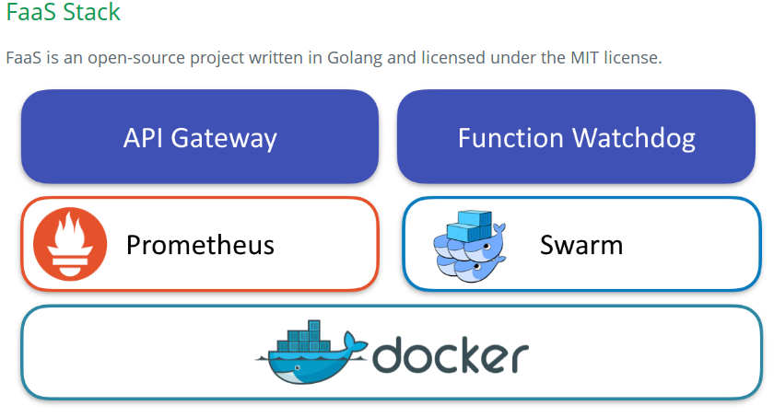

Going further
AWS Lambda - High mem: 1536 MB
266,667/seconds/month free
Aliyun / Alibaba Cloud - China
Need to register with +86 mobile number
IBM OpenWhisk
Docker
Build your own FaaS infrastructure
https://github.com/alexellis/faas
UI portal
Setup with one script
Any process that can run in Docker can be a serverless function
Prometheus metrics and logging
Auto-scales as demand increases

Slide 50

github.com/ryanbaxendale/thunderstruck-demo
Notes:
https://www.artstation.com/artwork/ZxVox

